Slide 1
Leveraging AMD Ryzen AI PCs: Mastering LLM and CNN in Practice
黃彥勲
Sean Huang
Notes:
在AMD平台打造您的大型語言模型(LLM)應用

Slide 2

Lesson Outline
Setting Up Your AMD AI PC
Performing Computer Vision Tasks on Ryzen AI PC
Preparations for Working With LLMs
LLM Deployment Using Ryzen AI PC (Ollama/Lemonade)
Function Calling Application
RAG Using SentenceTransformer
Code and slides can be found at: https://github.com/jonathansimple/amd-ai-pc
Notes:
24.10

Slide 3
Overview
Introduction
This course serves as an introductory guide for those interested in deploying LLM solutions on AMD’s RyzenTM AI PCs. It covers a high level discussion on the foundation of CNNs and LLMs and includes practical implementations attendees can follow along.
Target Audience
Programmers familiar with Python
Developers interested in building LLM solutions on mid-high end edge computing devices
Developers looking to migrate CUDA solutions to AMD platforms
Anyone looking to dip their toes in their first LLM or computer vision project
Resources
Code and slides: https://github.com/jonathansimple/amd-ai-pc
Notes:
Beginner friendly course

Slide 4
Setting Up Your AMD AI PC

Slide 5
AMD Hardware and Driver Support
Two types of AMD hardware:
AI PCs - Ryzen AI 300-series PCs with iGPU + NPU
Desktops – GPUs like RX 6800 and W6800 and up
What’s the difference?
Different hardware require different drivers:
AI PCs: NPU drivers + Ryzen AI Software
Desktops: ROCm (Linux), HIP SDK* (Windows)
*HIP (Heterogeneous-computing Interface for Portability) SDK for Windows brings a subset of the ROCm platform to Windows
Notes:
https://github.com/amd/RyzenAI-SW/blob/main/example/llm/lemonade/cpu/Llama_3_2_1B_Instruct.md
NPU drivers: https://ryzenai.docs.amd.com/en/latest/inst.html#install-npu-drivers
Rocm link: https://rocm.docs.amd.com/projects/install-on-linux/en/latest/install/quick-start.html
Windows rocm compatibility: https://rocm.docs.amd.com/projects/install-on-windows/en/latest/reference/system-requirements.html
Windows installation: https://rocm.docs.amd.com/projects/install-on-windows/en/latest/index.html#hip-install-quick

Slide 6
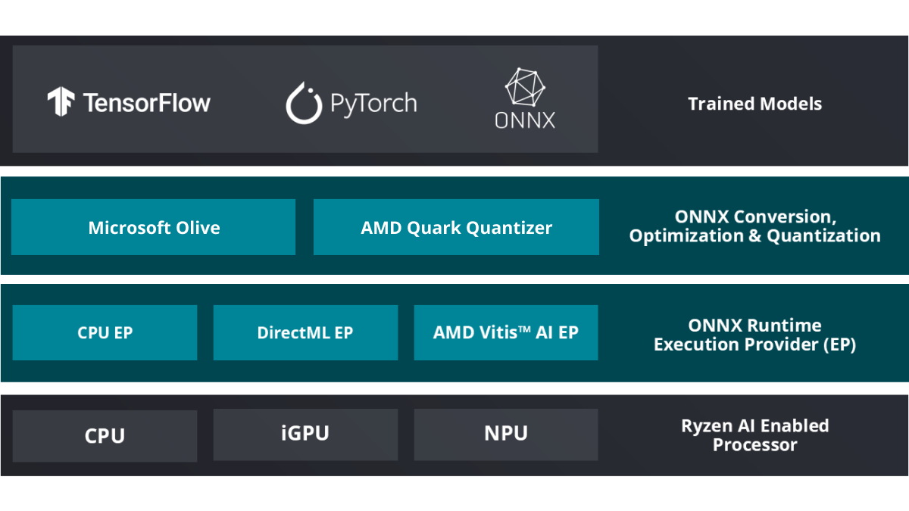
Ryzen AI Software
https://ryzenai.docs.amd.com/en/latest/inst.html
Notes:
AMD Ryzen™ AI Software includes the tools and runtime libraries for optimizing and deploying AI inference on AMD Ryzen™ AI powered PCs. Ryzen AI software enables applications to run on the neural processing unit (NPU) built in the AMD XDNA™ architecture, as well as on the integrated GPU. This allows developers to build and deploy models trained in PyTorch or TensorFlow and run them directly on laptops powered by Ryzen AI using ONNX Runtime and the Vitis™ AI Execution Provider (EP).

Slide 7
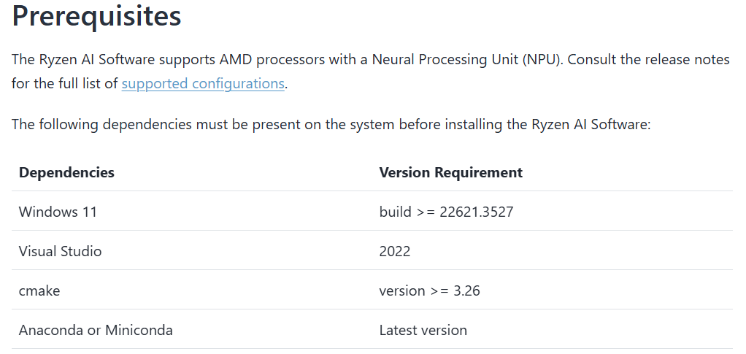
AI PC NPU Driver Installation (Windows)
Go to: https://ryzenai.docs.amd.com/en/latest/inst.html#install-npu-drivers
Ensure your system has the prerequisites installed
Notes:
https://ryzenai.docs.amd.com/en/latest/inst.html#install-npu-drivers

Slide 8
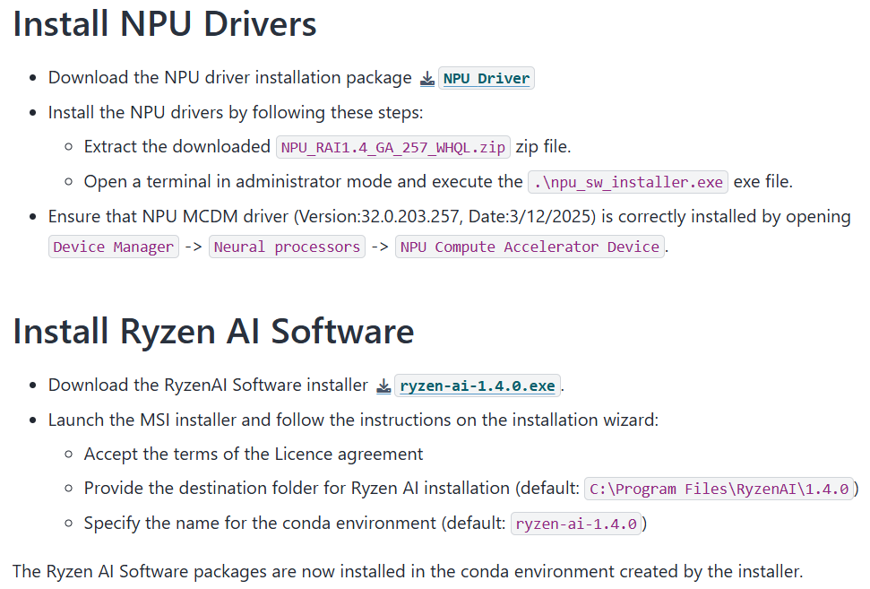
AI PC NPU Driver Installation (Windows)
Create an AMD account and download + run the installers (free)
Notes:
https://ryzenai.docs.amd.com/en/latest/inst.html#install-npu-drivers
Sample demo: https://github.com/amd/RyzenAI-SW/blob/main/example/llm/lemonade/hybrid/Llama_3_2_1B_Instruct.md

Slide 9
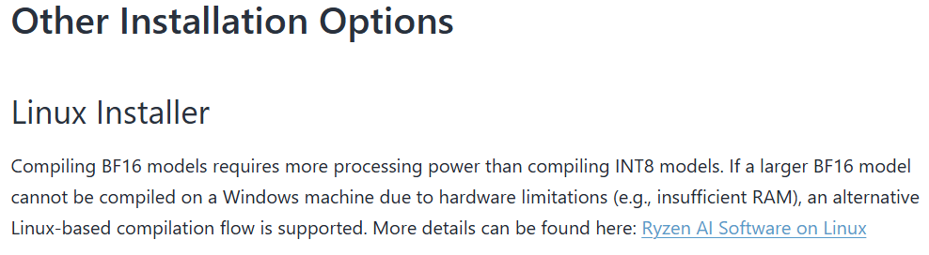
AI PC NPU Driver Installation (Linux)
A Linux installer can be found at the bottom of https://ryzenai.docs.amd.com/en/latest/inst.html
Notes:
https://ryzenai.docs.amd.com/en/latest/inst.html#install-npu-drivers
Sample demo: https://github.com/amd/RyzenAI-SW/blob/main/example/llm/lemonade/hybrid/Llama_3_2_1B_Instruct.md

Slide 10
Porting Nvidia-Based Solutions to AI PCs
Minor code change needed
AI PCs rely on the onnx runtime to enable NPU acceleration, without it, computation will default to GPU/CPU
Projects with CPU-only fallback solutions do not need to be modified
When setting up this environment, I strongly recommend following AMD’s Ryzen AI Software + NPU driver installation (the Ryzen AI Software installer will set up a compatible conda environment for you)

Slide 11
Download Demo Files
Clone the repo at https://github.com/jonathansimple/amd-ai-pc
git clone https://github.com/jonathansimple/amd-ai-pc.git

Slide 12
Performing Computer Vision Tasks on AI PCs

Slide 13
Install Dependencies
Navigate to the CNN demo directory:
cd image_classification
Create a clone of your Ryzen AI environment:
conda create --name resnet_bf16 --clone ryzen-ai-1.5.0
conda activate resnet_bf16
Add your Ryzen AI software folder to your environment variable (default is C:\Program Files\RyzenAI\1.5.0) and install missing dependencies:
set RYZEN_AI_INSTALLATION_PATH = <path/to/RyzenAI/installation>
python -m pip install -r requirements.txt

Slide 14
Download Model and Dataset
Run the following to download the dataset and export the model to onnx format:
python prepare_model_data.py
Quantize the ResNet model to bf16 using:
python compile.py --model models\resnet_trained_for_cifar10.onnx
Expected output:
[Vitis AI EP] No. of Operators : VAIML 124
[Vitis AI EP] No. of Subgraphs : VAIML 1
Done

Slide 15
Deploy Model
Inference on NPU:
python predict.py --ep npu
Expected output:
execution started on NPU
[Vitis AI EP] No. of Operators : VAIML 124
[Vitis AI EP] No. of Subgraphs : VAIML 1
Image 0: Actual Label cat, Predicted Label cat
Image 1: Actual Label ship, Predicted Label ship
…
Inference on CPU:
python predict.py

Slide 16
Preparations for Working With LLMs

Slide 17
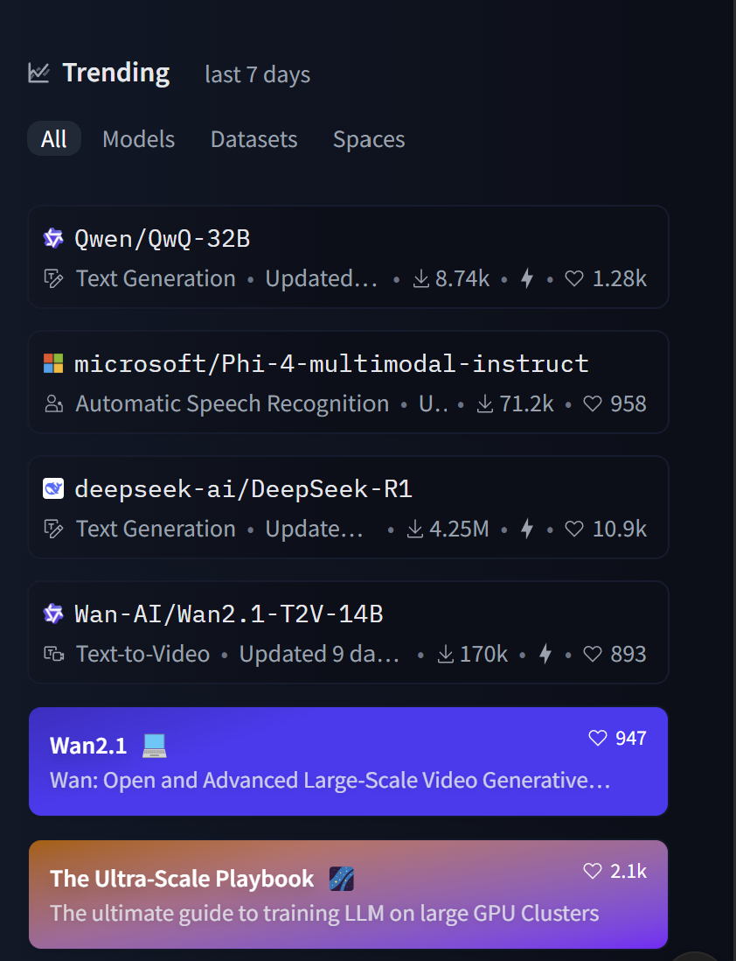
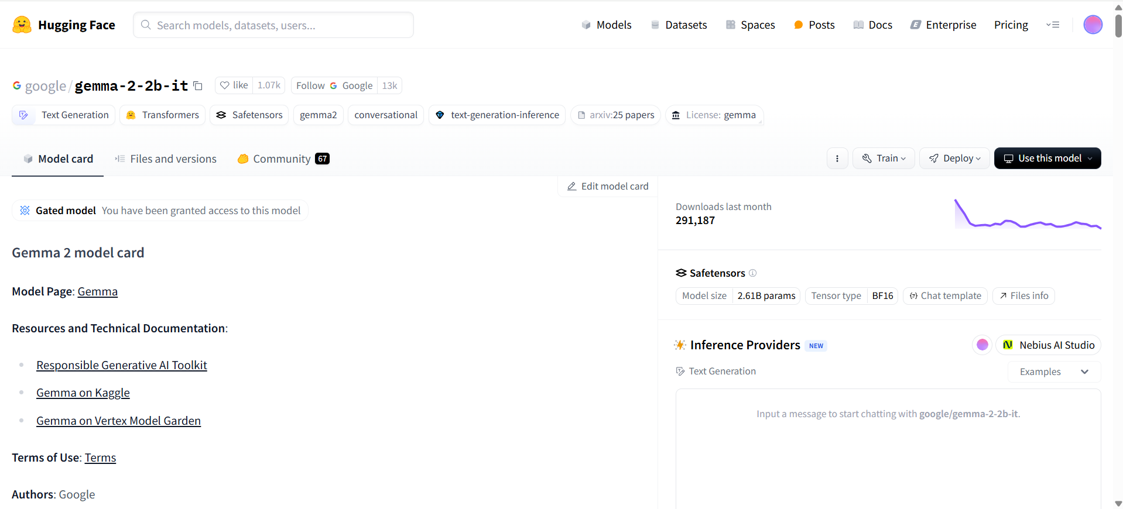
Downloading LLMs
Where can I find LLM models: https://huggingface.co/
You can find trending (new) models on the home page
Hugging Face has the widest selection of models to sample
Example of what a model’s Hugging Face page looks like

Slide 18
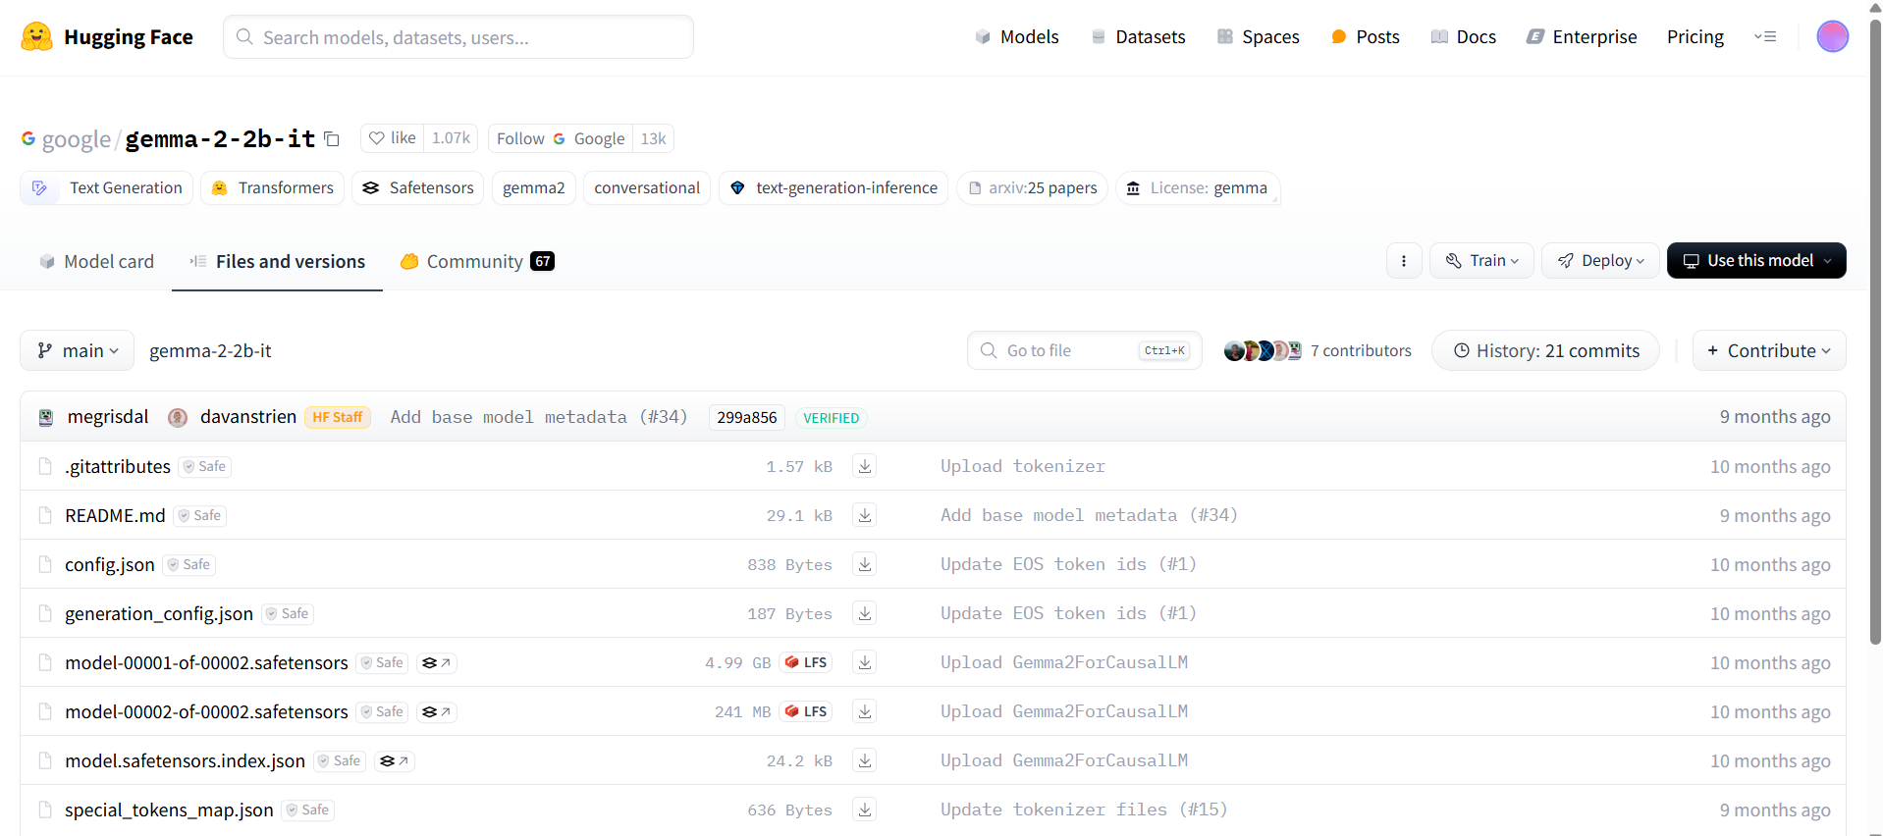
Downloading LLMs (1) – Manual Download

Slide 19
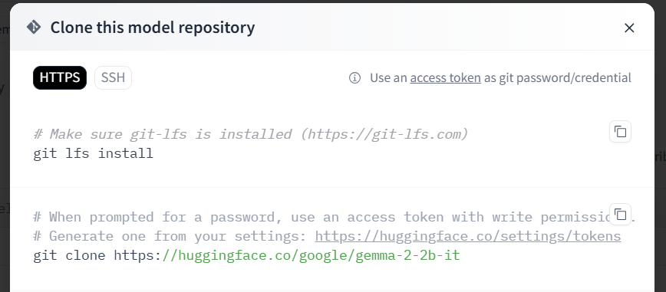
Downloading LLMs (2) - Git

Slide 20
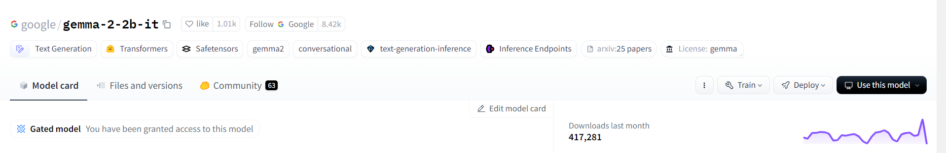
Downloading LLMs (3) – Hugging Face/Transformers
google/gemma-2-2b-it
Running models hosted on Hugging Face (this will save the models inside the Hugging Face library folder):
tokenizer = AutoTokenizer.from_pretrained("google/gemma-2-2b-it", trust_remote_code=True)
model = AutoModelForCausalLM.from_pretrained("google/gemma-2-2b-it", trust_remote_code=True, device_map=0)
Running local/downloaded model:
tokenizer = AutoTokenizer.from_pretrained("/home/sean/Desktop/qlora-main/gemma2-2b-it", trust_remote_code=True)
model = AutoModelForCausalLM.from_pretrained("/home/sean/Desktop/qlora-main/gemma2-2b-it", trust_remote_code=True, device_map=0)

Slide 21
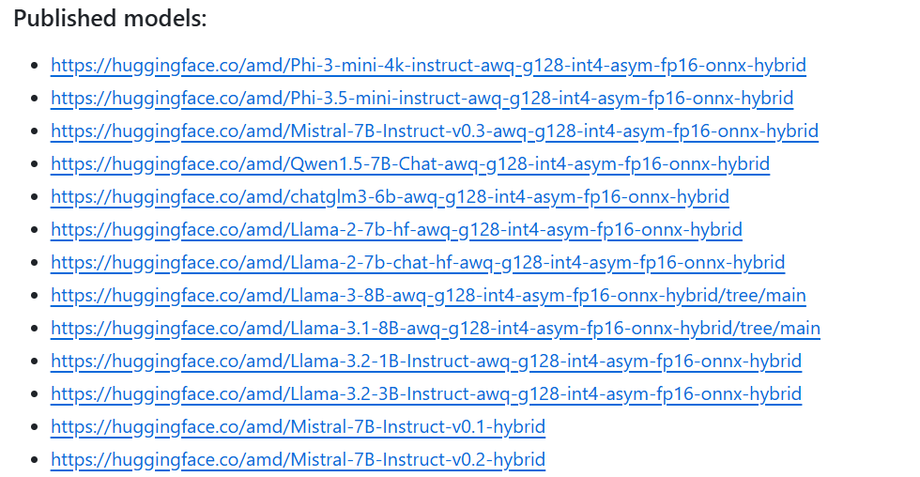
Ryzen AI LLM - Onnxruntime GenAI (OGA)
AMD provides a set of pre-optimized LLMs on Hugging Face ready to be deployed with Ryzen AI Software: https://github.com/amd/RyzenAI-SW/tree/main/example/llm/oga_api

Slide 22
Problem with Hugging Face Solutions
Models hosted on Hugging Face usually aren’t optimized for speed but rather accuracy and reproducibility, for example:
Models are usually uploaded as full precision models (quantized models lose precision but are smaller and faster, better for edge deployment)
Models are ran on transformers (common library for development/training, extremely slow – can be upwards of 10 times slower – compared to other inferencing frameworks)
As such, it is recommended to use options such as Ollama or Lemonade for model deployment (inference only)

Slide 23
Introduction to Ollama

Slide 24
Ollama
Great tool for hosting LLMs locally
Based on llama.cpp – optimized for speed
Works on Linux, Windows, macOS
Supports a wide variety of models but has fewer selection than Hugging Face – if you can’t find the model you are looking for, you can import your own model (in GGUF format)
Notes:
Benefits of locally hosting llms

Slide 25
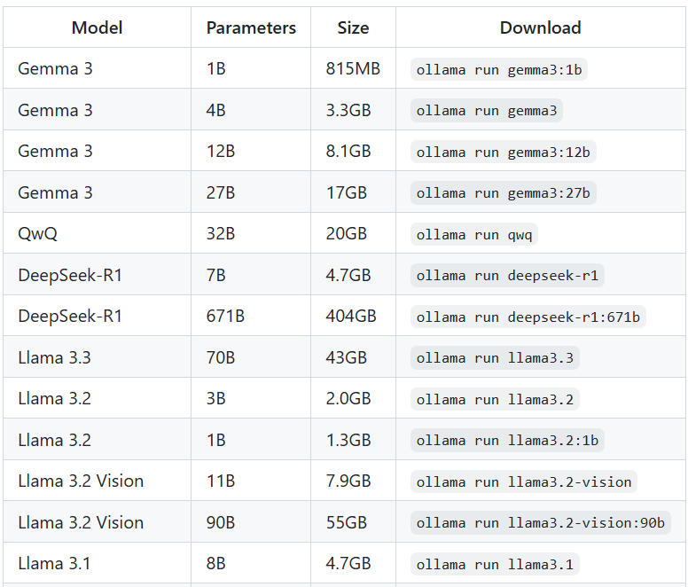
Setting Up Ollama (Linux)
Installation:
curl -fsSL https://ollama.com/install.sh | sh
Downloading a model:
ollama pull gemma3:1b-it-qat
Running a model:
ollama run gemma3:1b-it-qat
Print out all available (downloaded) models
ollama list
A non-exhaustive list of readily available models

Slide 26
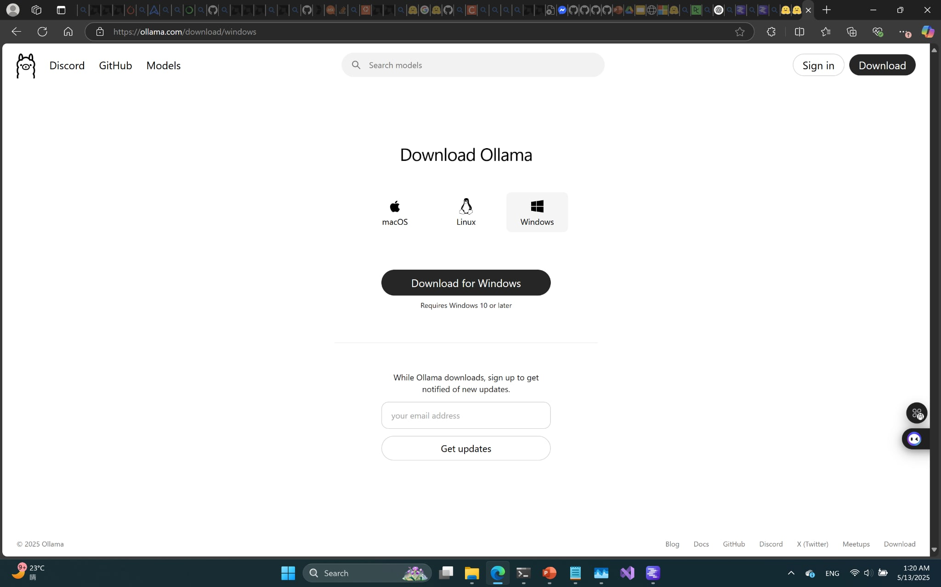
Setting Up Ollama (Windows)
A straightforward installer is available for Windows (simply download and run)

Slide 27
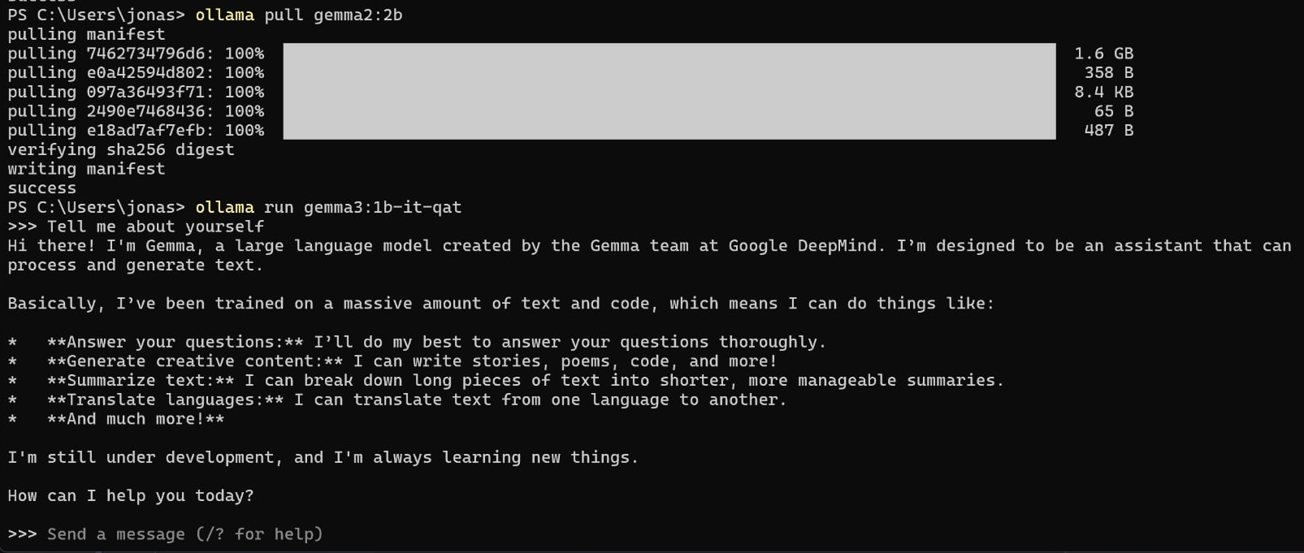
Running Ollama as a Chatbot on Command Line
Use the command: ollama run gemma3:1b-it-qat

Slide 28
Using Ollama as a Server
A command line chatbot isn’t very useful, but Ollama can be used as an OpenAI API compatible server to handle query requests
How do we set up an Ollama server?
On your machine’s bootup, Ollama should already be running by default, if not, run ollama serve
What models are available?
All of the model listed when you call ollama list
What is the server’s address?
By default, the Ollama server is posted on http://localhost:11434/v1

Slide 29

OpenAI API
The OpenAI API is a broadly supported standard for enabling applications to communicate with LLM servers
Applications and servers communicate in a multi-role conversation
Role | Description
system | Allows the application to provide instructions to the LLM, such as defining its persona, what tools are available, what tasks it is supposed to help with or not help with, etc.
assistant | Messages sent from the LLM to the application.
user | Messages sent from the application to the LLM. Often these messages are written by the application's end-user.
Notes:
https://lemonade-server.ai/docs/

Slide 30
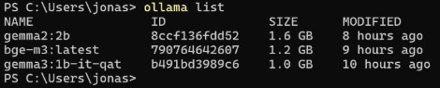
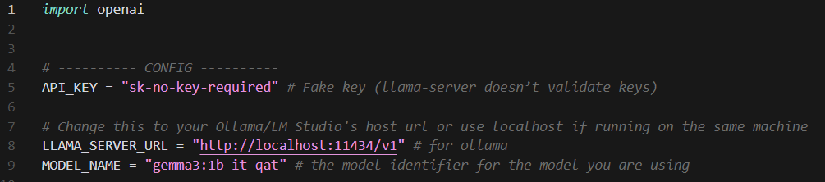
Sending a Query to Your Ollama Server (inference_ollama.py)
List of available LLMs
The model names should match those shown when calling ollama list

Slide 31
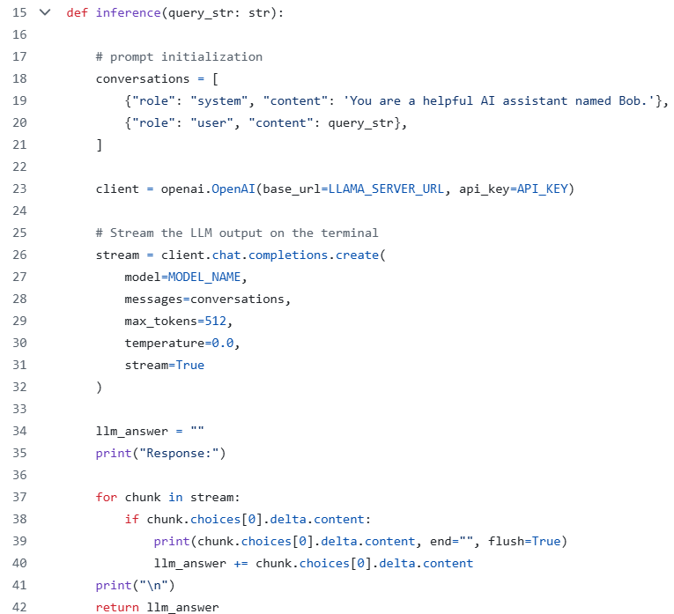
Sending a Query to Your Ollama Server (inference_ollama.py)
Label your query and add any system prompts you wish
Create a client pointing to your Ollama server
The chat completion is where you specify which model you wish to use
Because we set stream=True, the LLM tokens will be streamed to the terminal in real time

Slide 32
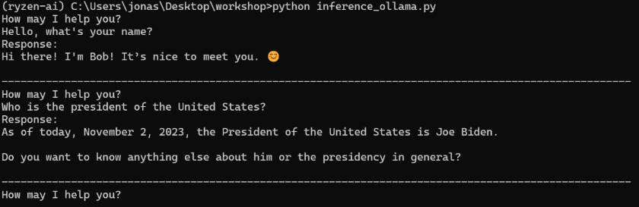
Using Ollama as a Server (inference_ollama.py)
You will need to run pip install openai on the default Ryzen AI environment before running the script

Slide 33
Introduction to Lemonade

Slide 34

What is Lemonade SDK?
Lemonade is a library for running large language models (LLMs) on your PC
Lemonade maximizes LLM speed using neural processing units (NPUs) and Vulkan GPU acceleration
Lemonade supports both GGUF and ONNX models
Notes:
https://lemonade-server.ai/docs/

Slide 35
What is a Lemonade Server?
A Lemonade Server is a local LLM that can be interfaced with using the standard OpenAI API
It allows applications to leverage local LLMs via API calls
Works similarly to Ollama
Notes:
https://lemonade-server.ai/docs/

Slide 36
What is a Local (LLM) Server
Local servers are systems that run server software on client hardware
Benefits of a local server:
Data privacy
LLM resource sharing across applications
Separation of functions
Cloud-to-client development transition
Easy code integration and iteration framework and devices are not baked into the code (only base_url, api_key, and model need to be modified)

Slide 37
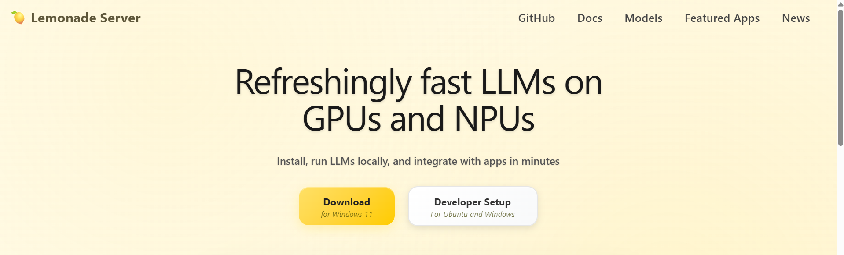
Installing Lemonade (Windows)
https://lemonade-server.ai/
Lemonade is optimized for Windows, it is recommended to install using the .exe installer

Slide 38
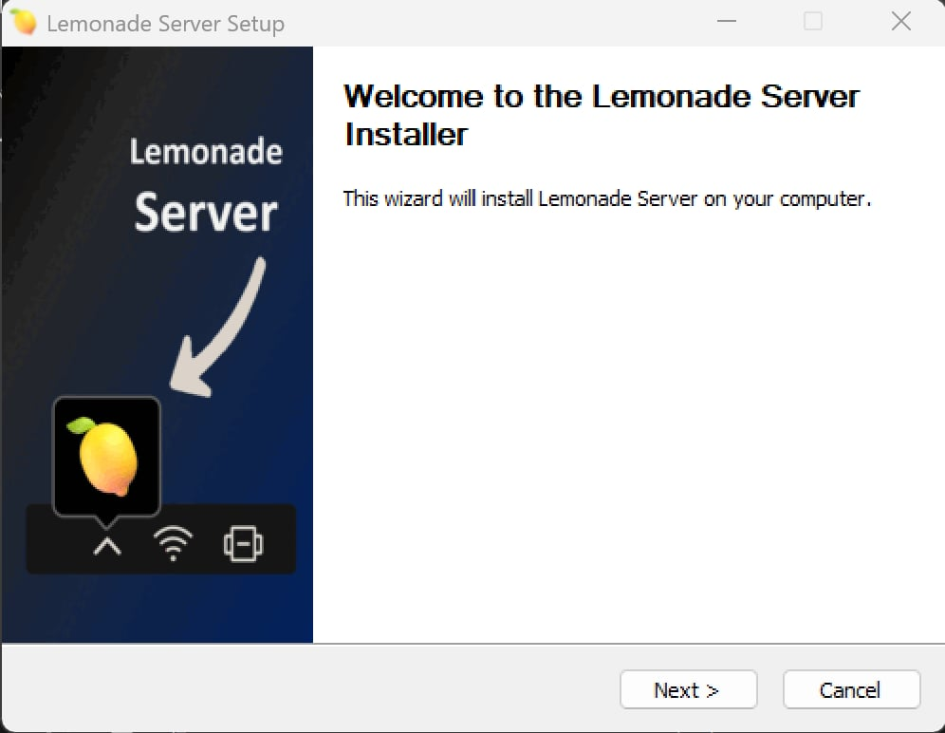
Installing Lemonade (Windows)

Slide 39
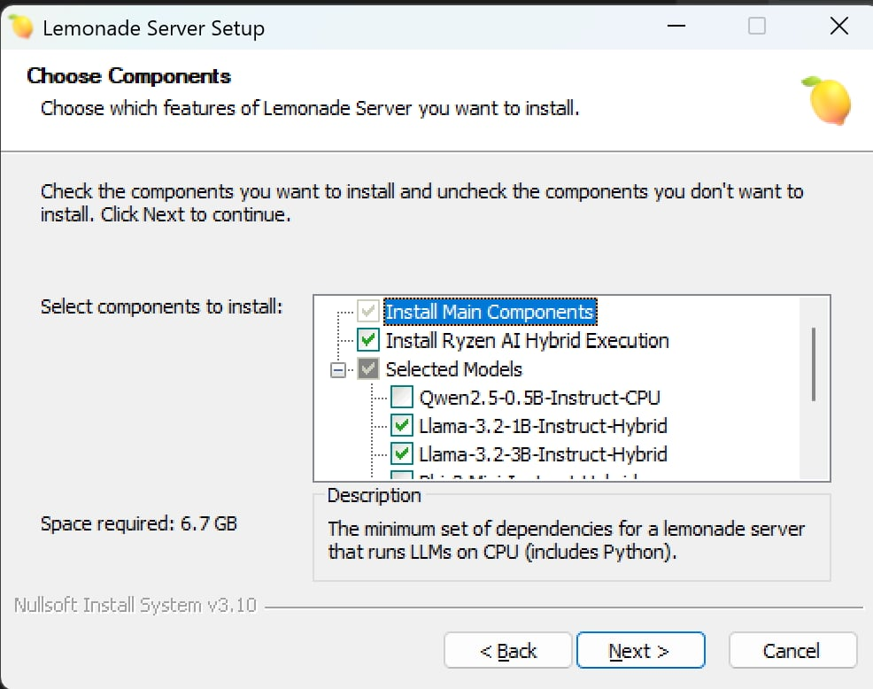
Installing Lemonade (Windows)

Slide 40
Installing Lemonade (Linux)
https://lemonade-server.ai/
Lemonade is also available on Linux at a lower capacity

Slide 41
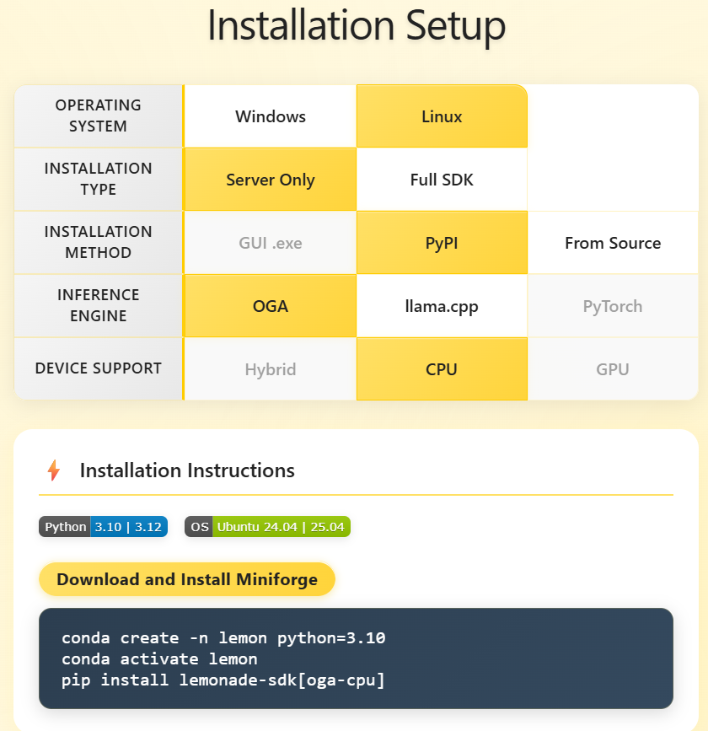
Installing Lemonade (Linux)
Support for OnnxRuntime GenAI (OGA) is limited on Linux (oga-cpu only, hybrid unavailable)
For non-onnx models, device support can be set to GPU

Slide 42
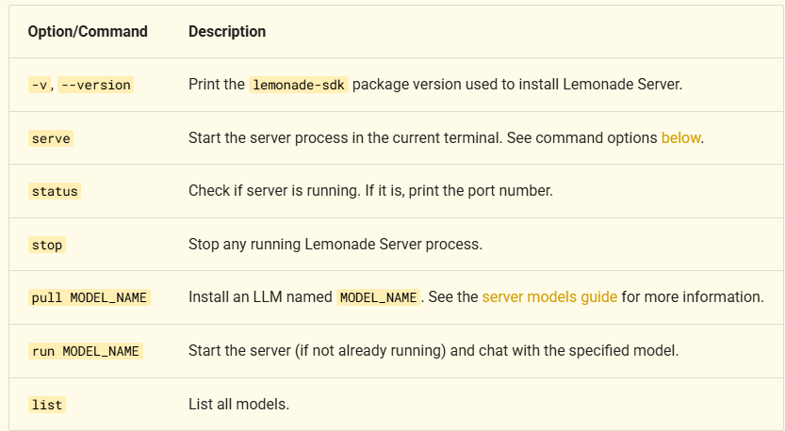
lemonade-server CLI
lemonade-server command-line interface (CLI) is a set of commands used to manage the LLM server
Starting a server via command line:
lemonade-server serve --port 8000 --log-level debug --truncate-inputs

Slide 43
Other Useful Resources for CLI
Use the pull command to download models (uses Hugging Face Hub)
lemonade-server pull Qwen2.5-0.5B-Instruct-CPU
By default, Hugging Face downloads models to C:\Users\YOUR_USERNAME\.cache\huggingface\hub
You can change the directory for Hugging Face Hub by setting the HF_HOME or HF_HUB_CACHE environment variables.
Visit https://lemonade-server.ai/docs/server/server_integration/ for more information on working with Lemonade’s command line interface

Slide 44
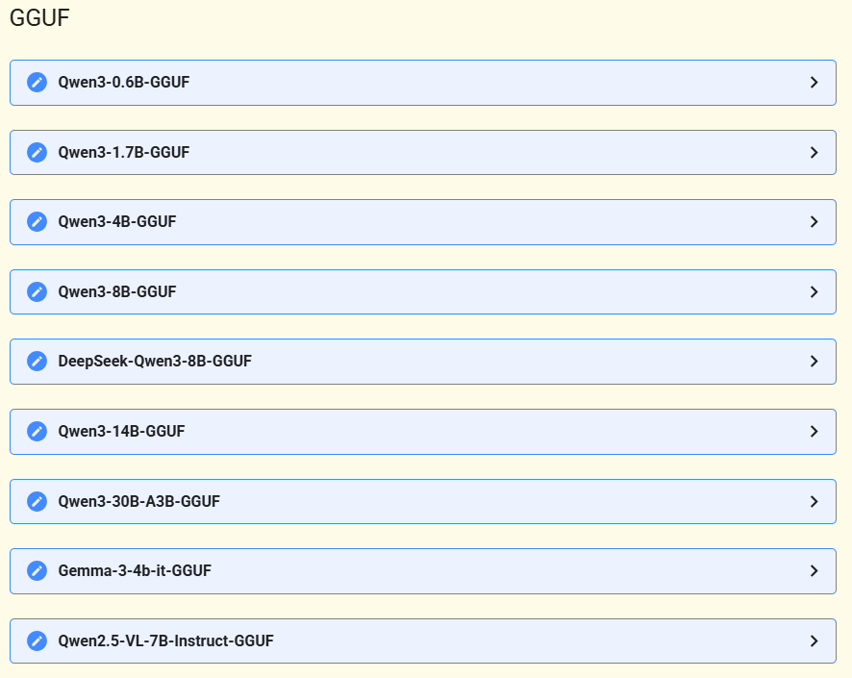
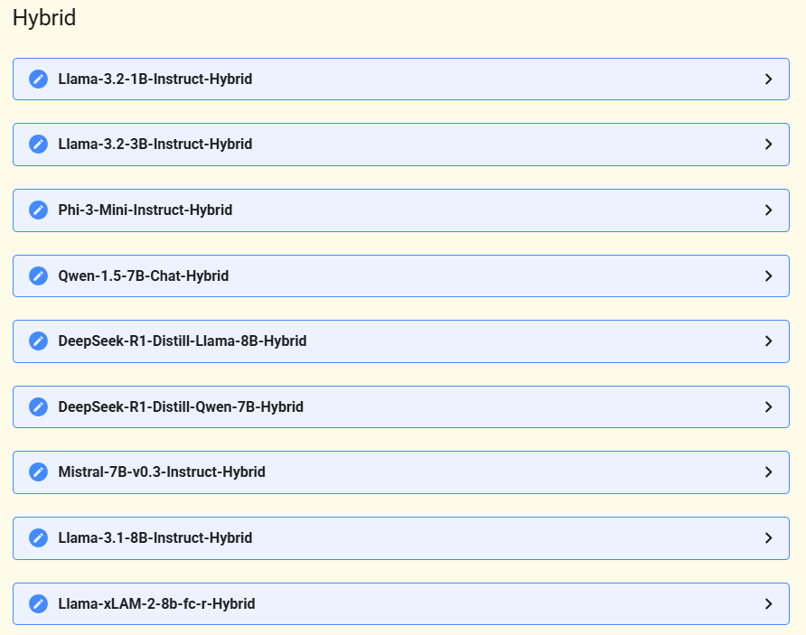
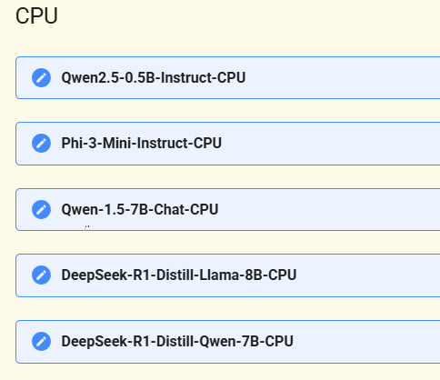
Lemonade Supported Models
https://lemonade-server.ai/docs/server/server_models/

Slide 45
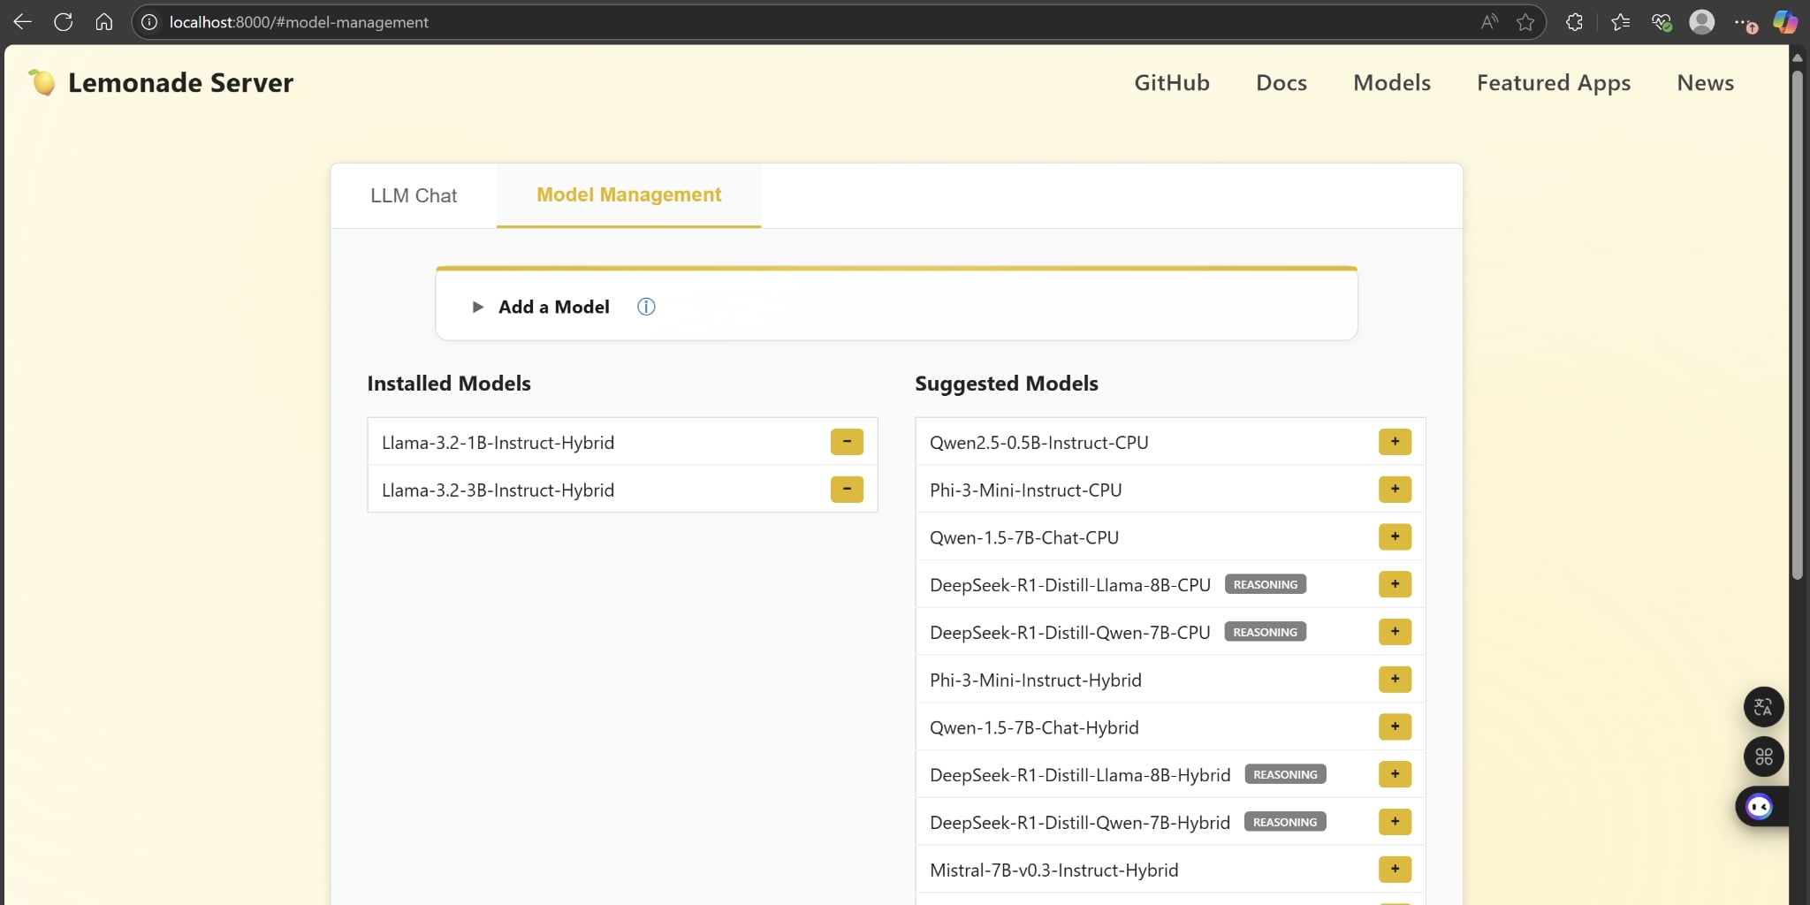
GUI Based Model Storage and Management
Lemonade Server offers a model management GUI to help you see which models are available, install new models, and delete models.
You can access this GUI after starting Lemonade Server at http://localhost:8000 in your browser (remember to adjust the port number if you called serve with a non-default port)

Slide 46
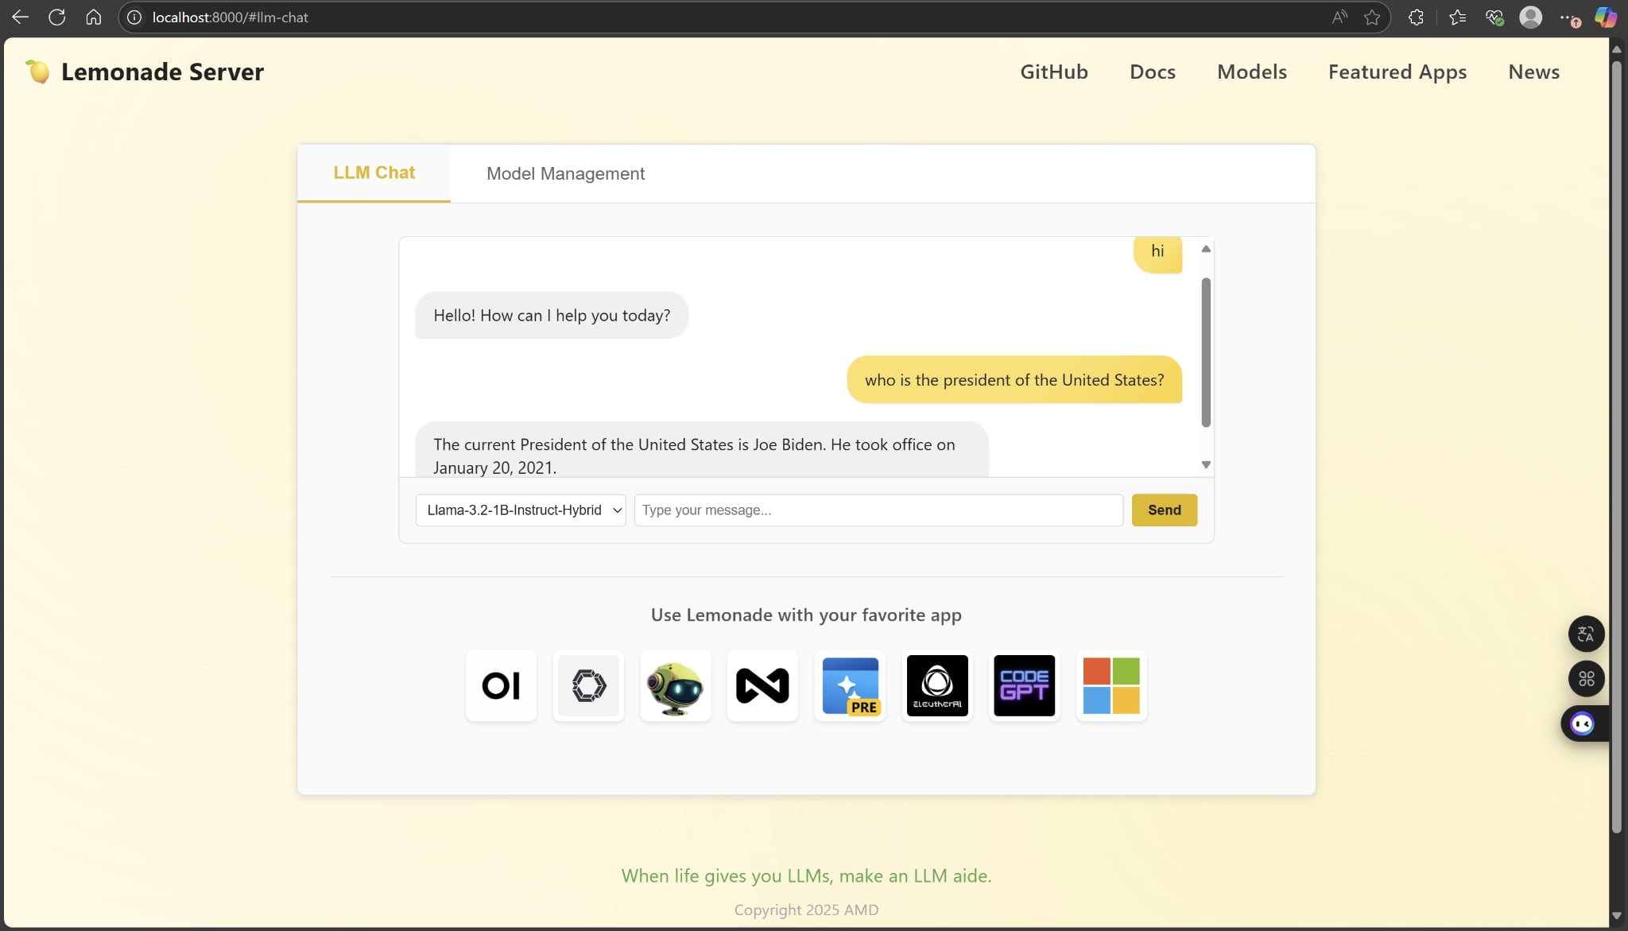
GUI Based Chat Bot
You can also chat with your installed LLMs on the same GUI under the LLM Chat tab

Slide 47
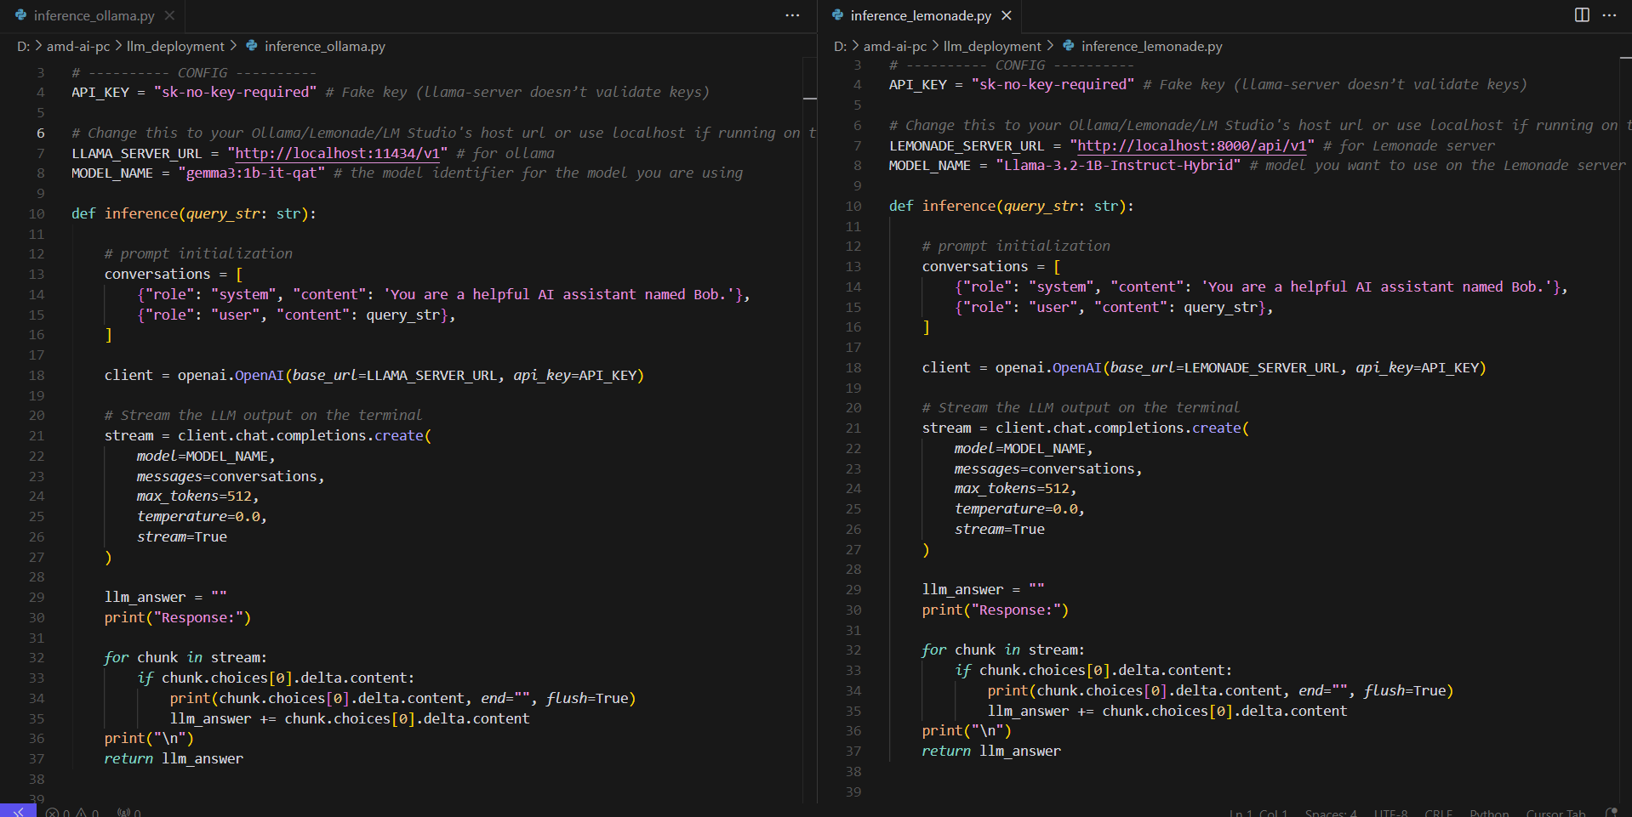
Sending a Query to Your Lemonade Server (inference_lemonade.py)
Same exact usage as Ollama, just different server address and model names

Slide 48
Inferencing - Function Calling

Slide 49
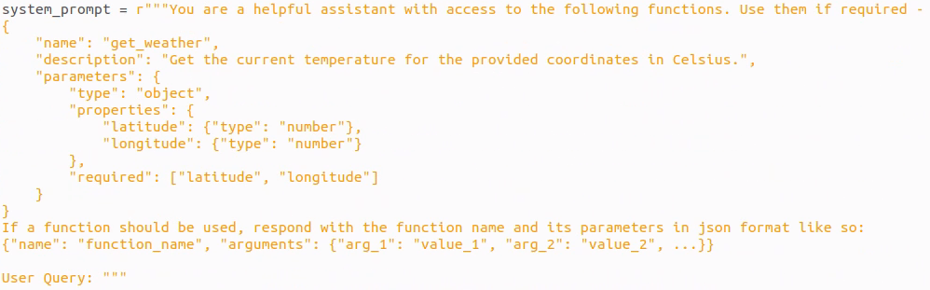
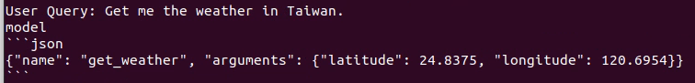
Function Calling Example: Function Declaration
The description fields are important for informing the LLM on when a function should be used
Sample output, the model provides the coordinates to Taiwan using its existing knowledge

Slide 50
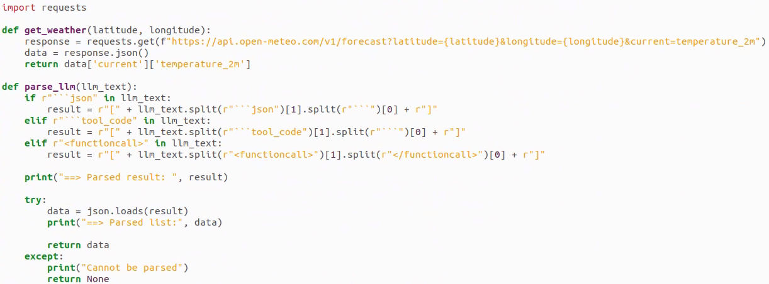
Function Calling Example: API Integration
API call
temperature_2m is the temperature 2 meters above ground
Handle LLM’s structured output
Parse LLM output (string) into json

Slide 51
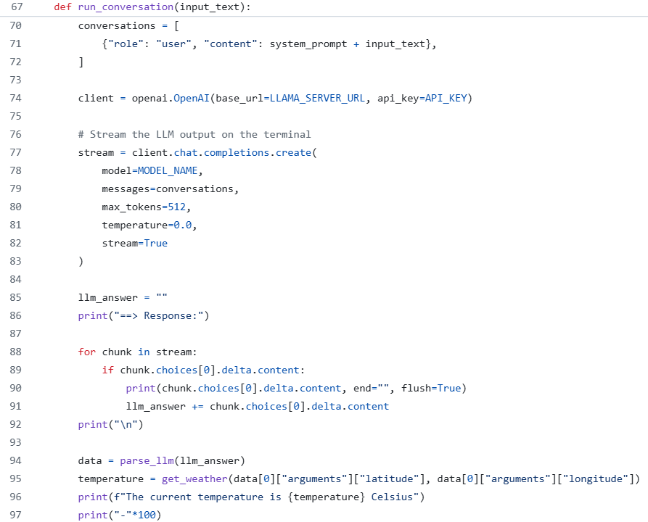
Function Calling Example: Inference Step (function_calling_ollama.py)
Format user query and add function list to query
Config client
Send request to server and stream output
Parse LLM output as json and call the correct function using function name and use the correct function input using arguments
Call API

Slide 52
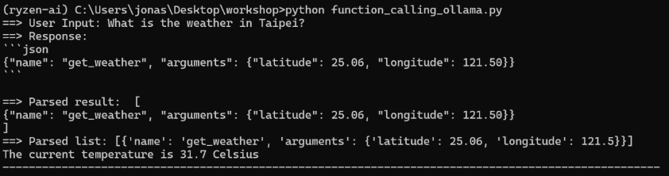
Function Calling Example: Output (function_calling.py)

Slide 53
RAG Using Ollama and SentenceTransformer

Slide 54
Problem Rehash
Why RAG?
Some models have outdated information, but we don't want to fine tune the model
Difference between RAG and normal inference:
Additional context for generation is provided (normally you only have the query)
As a result, your prompt will look different
Here is a very simple RAG prompt:
Context: Donald Trump won the 2024 presidential election and remains president in 2025. Most new models can perform function calling out-of-the-box.
Question: Who is the president of the United States in 2025?
Answer:

Slide 55
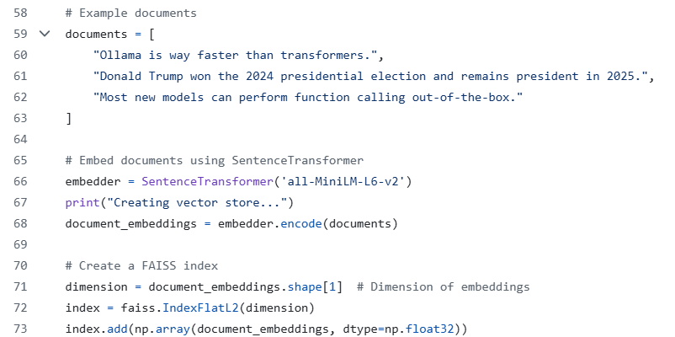
Building a Vector Store for Retrieving Relevant Context (rag_query.py)
One of many examples of building a vector store using FAISS, other vector store library options include langchain and llama_index

Slide 56
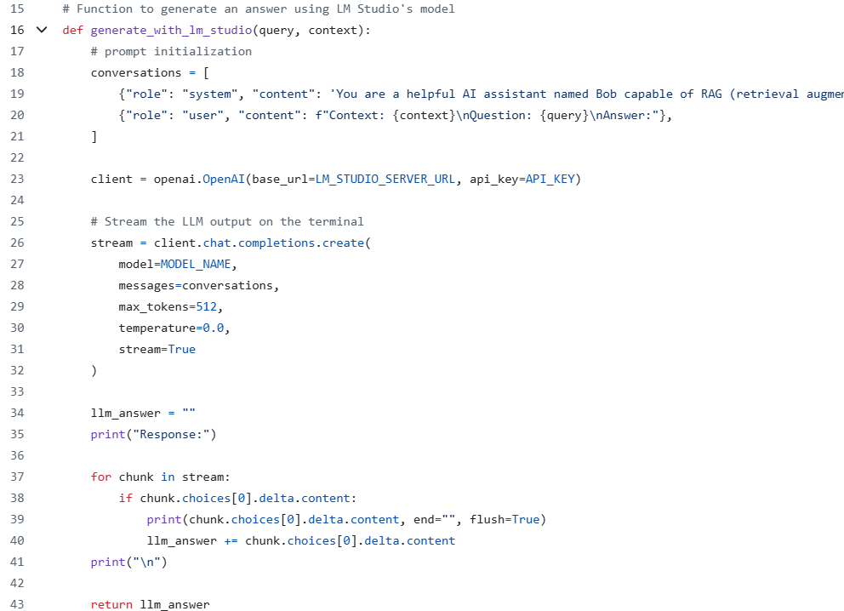
Generating a Response using LM Studio (rag_query.py)
Very similar to the Ollama client code, the only difference here is that the system prompt and user prompt have been modified to be more RAG friendly.

Slide 57
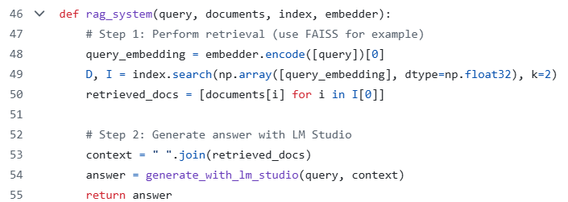
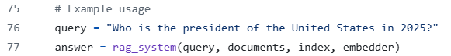
Putting Everything Together (rag_query.py)
Find the top 2 documents that most closely relate to the query
Concat the retrieved contexts for the RAG prompt
End-to-end function call

Slide 58
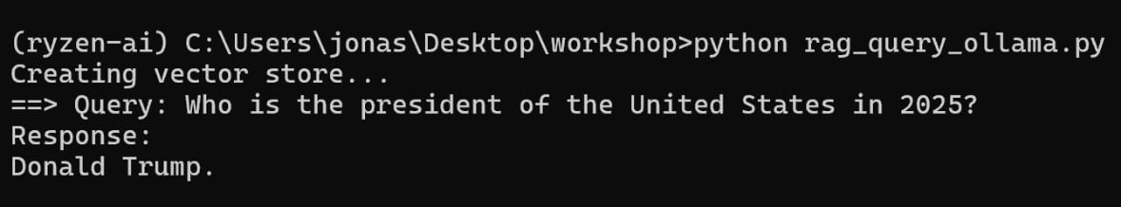
RAG Using Ollama and LM Studio (rag_query.py)

Slide 59
Conclusion
In this course, we discussed how to:
Perform basic computer vision tasks on Ryzen AI PCs
Perform function calling using LLMs
Improve a LLM's factual accuracy without fine tuning using RAG
To do this, we covered:
What are AI PCs, LLMs, tokenizers, and function calling
How to craft prompts to maximize a LLM's potential
How to inference using a variety of platforms (transformers, Ollama, LM studio)

